Slide 1



Slide 2

Tell Stories with Azure Workbooks

Slide 3





Samik Roy
Lead Cloud Developer
Open Systems
M365 Security, Microsoft Sentinel
Speaker | Trainer | Community Contributor
https://github.com/samikroy
samik.n.roy@gmail.com
linkedin.com/in/samikroy
@roy_samik

Slide 5
Module agenda
Jumpstart with Azure Workbooks
Understand various template available
Build a workbook from scratch
QnA

Slide 6
Lesson introduction
After this lesson, you will be able to:
How to build a workbook
Play with existing workbooks

Slide 7
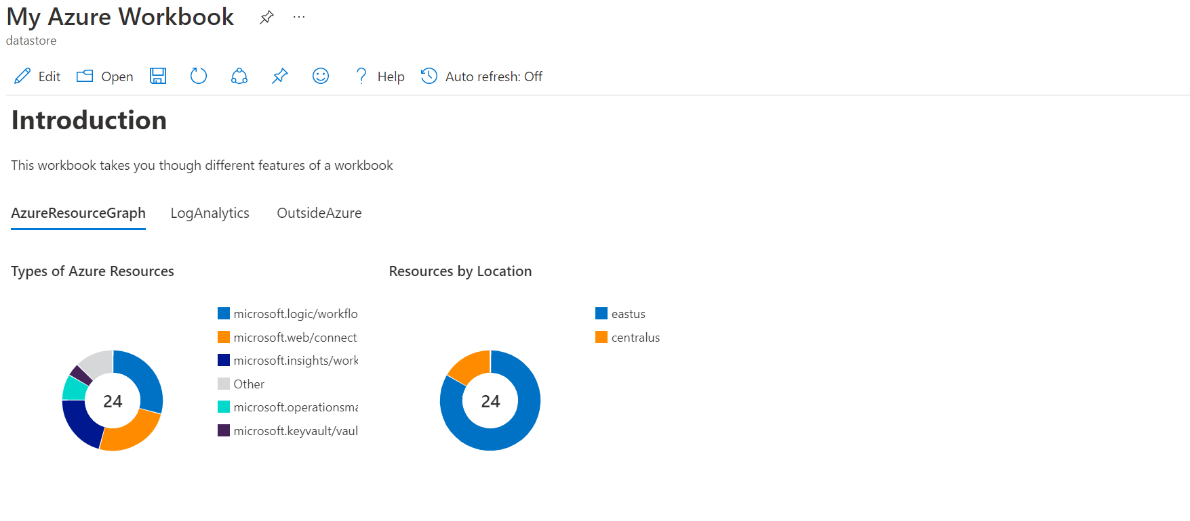
Jumpstart with Azure Workbooks

Slide 8
Understand various template available
Some examples
Sentinel Template –
https://github.com/Azure/Azure-Sentinel/tree/master/Workbooks
Azure Community Workbooks - https://github.com/microsoft/Application-Insights-Workbooks

Slide 9
Build a workbook from scratch

Slide 10

Questions

Slide 11
Thank you

